Slide 1
Credit Card Fraud Detection POC

Slide 2
Agenda
Introduction
Problem definition
What you will learn
Data Analysis
Anonymized data
Feature analysis
Supervised model
LightGBM Model
Feature importance and model explainability
Metric and cost function
Demo
Postman, MongoDB setup
Code walkthrough
Run inference
Run retraining
Visualize results
Homework

Slide 3
INTRODUCTION
Problem definition

Slide 4
INTRODUCTION
Problem definition
Data contains transactions made by credit cards in September 2013 by European cardholders. There are 492 frauds out of 284,807 transactions (0.17%).
Build a model for credit card fraud detection – to detect if a transaction is fraudulent or not.
Optionally, the model can use a cost function (costs are associated with both false negative and false positive events)
Data is anonymized, therefore use of domain specific knowledge is not applicable.

Slide 5
INTRODUCTION
What we will learn

Slide 6
INTRODUCTION
What we will learn
The focus of this POC is on productionizing the model, not on the model refinement
We will show the mechanism for performing inference, retraining, store transactions data, qualify the best model (based on chosen metric), and manual overwritten of inference transaction data
Limitations – for this POC
No user interface
No fancy dashboards (only graphs)
No container for the service
Only inference and retrain services are available, other services (like storage) are replaced with simple function calls

Slide 7
DATA ANALYSIS
Anonymized data

Slide 8
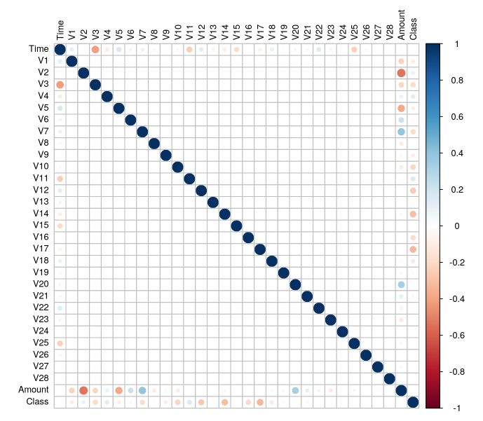
Anonymized data
Notes:
Looking to the Pearson correlation matrix for the features in the features set, including the target feature “Class”, we observe that most of the features are not correlated or with a very low correlation (or inverse correlation). The reason is that, for legal reasons, the data was anonymized. The features, as presented (from V1 to V28) are most probably the principal components resulted after applying principal component analysis to the original set of features.
So, using business knowledge in such a case is less likely, since most of the features are anonymized.

Slide 9
DATA ANALYSIS
Feature analysis

Slide 10
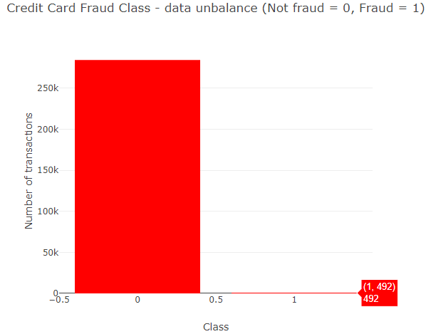
Feature analysis

Slide 11
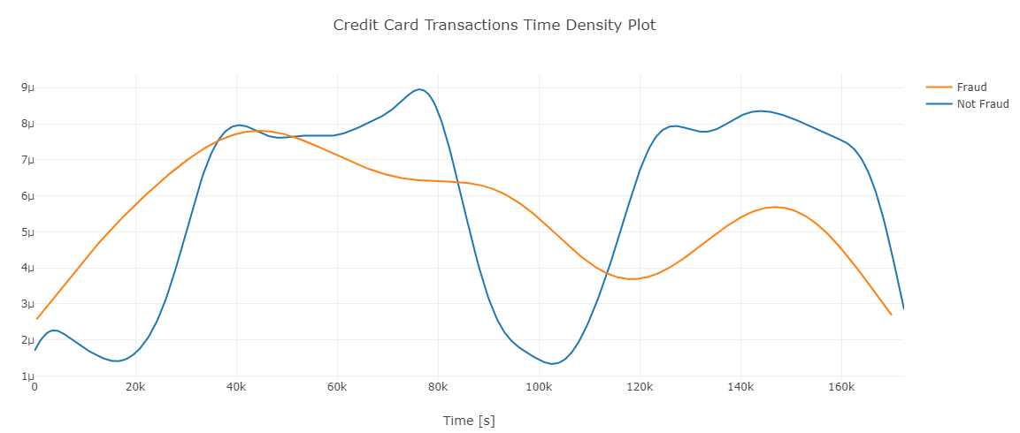
Feature analysis

Slide 12
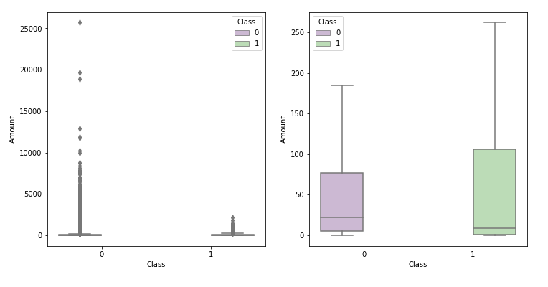
Feature analysis

Slide 13
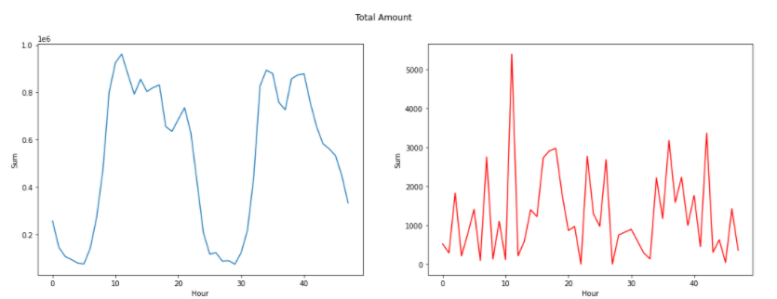
Feature analysis

Slide 14
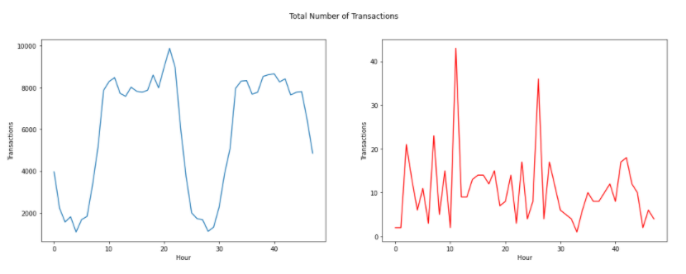
Feature analysis

Slide 15
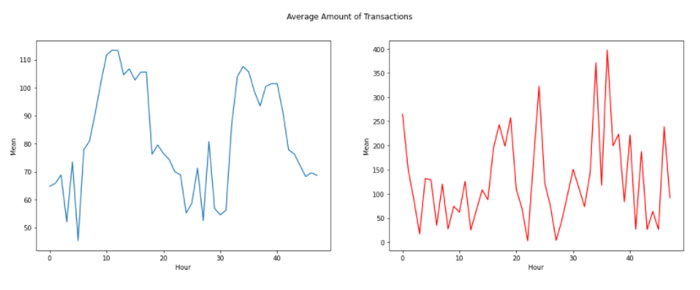
Feature analysis

Slide 16
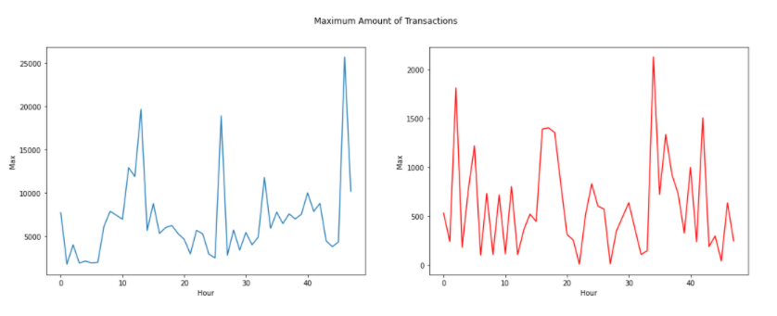
Feature analysis

Slide 17
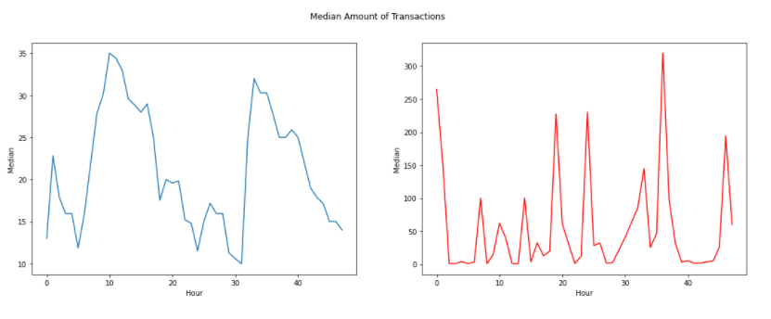
Feature analysis

Slide 18
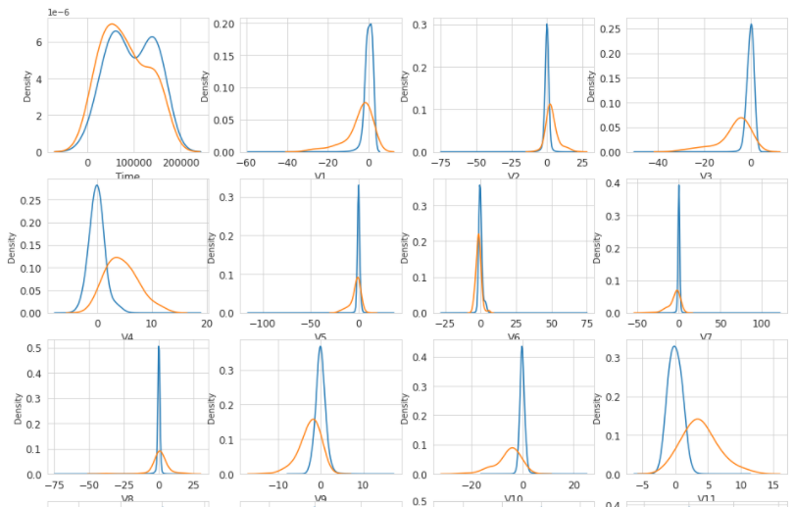
Feature analysis

Slide 19
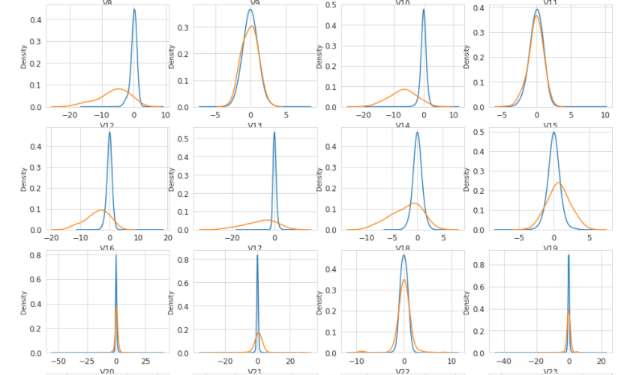
Feature analysis

Slide 20
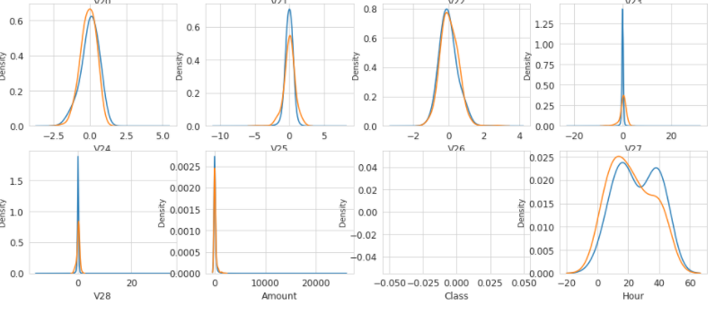
Feature analysis

Slide 21
SUPERVISED MODEL
LightGBM Model
Feature importance and model explainability
Metric and cost function

Slide 22
Supervised model
LightGBM Model
Train with 80% of the train data, test with 20%
Train-validation with cross-validation (5 folds, with StratifiedKFolds)
Metric used: AUC
Model hyperparameters from hyperparameters optimization
Save model upon training, store model data, model parameters, validation data (validation score overall, validation score on folds, features importance)
Inference for test data with model trained for each fold
Retrain after this with all the data

Slide 23
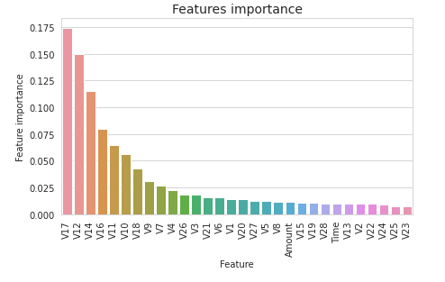
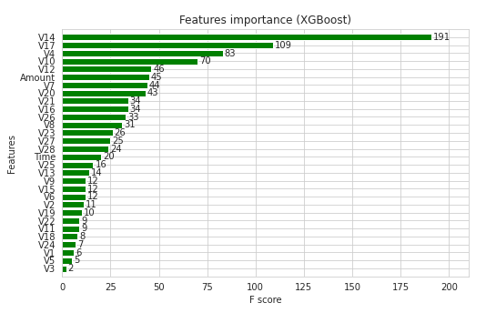
Supervised model
Feature importance and model explainability
Use feature importance to explain which features are more important for the model solution
RandomForest
XGBoost

Slide 24
Supervised model
LigthtGBM

Slide 25
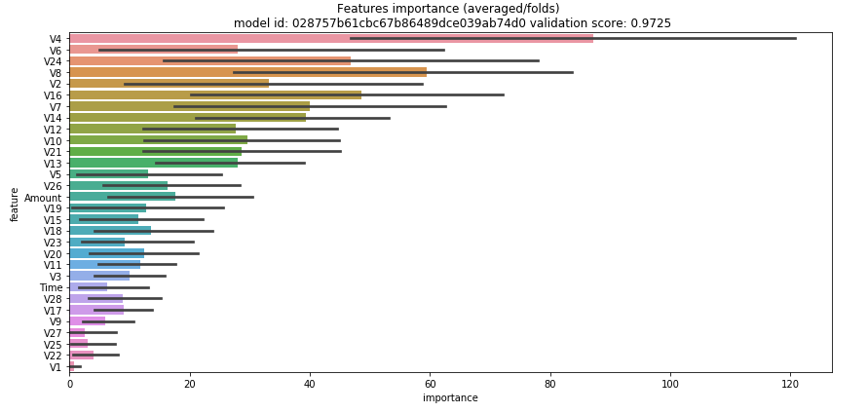
Supervised model
LightGBM – cross-validation

Slide 26
Supervised model
Metric and Cost Function
AUC is calculated for a collection of threshold values; the default implementation algorithm will assume that cost of FP & FN is the same (or not consider the cost function). By setting a cost function (with different values for FP & FN), we can optimize the threshold to minimize the cost function.

Slide 27
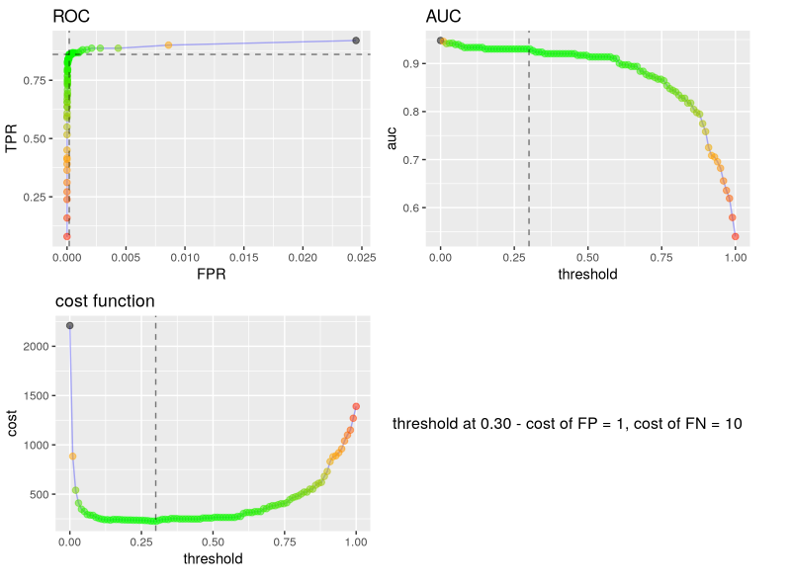
Supervised model
Metric and
Cost Function

Slide 28
DEMO
Postman, MongoDB setup
Run inference
Run retraining
Visualize results

Slide 29
HOMEWORK
Perform more feature engineering (ex: replace time with hour)
Add hyperparameters optimization
Experiment with undersampling, oversampling
Build a staked model (is this necessary?)
Store all models, not only the best (use binary storage)
Modify storage to be as well a service
Extract a module from visualization and use a specialized software for visualization
Create a user interface to support Inference, retrain, model and training parameters editing, visualization

